Slide 1
PAKISTAN
Refugee problem
Financial problem
The problem of asset distribution with India
The critical dispute of boundaries with India
Lack of administrative Infrastructure
Jinnah s death
Delay in constitution
War on Kashmir
1947-1958

Slide 3
1947-58
He setup administrative system of the country
Passed objectives resolution from the constituent assembly
Successfully signed ceasefire with India in Kashmir
Established central Bank in 1949
Assassinated in Rawalpindi on October 16,1951
Liaqat Ali Khan

Slide 4
1947-1958
His govt faced a number of problems like
The movement for protection of prophecy in Punjab
Food problem in Punjab
Anti-ahmadiya movement started by Ahrar organization
Ahrar were supported by CM Punjab Mian Mumtaz Dultana
First martial law was imposed in Lahore
On April 17,1953 the GG Ghulam Muhammad removed him from office
Khawja Nazim ud din

Slide 5
1947-1958
Ambassador of Pak to US
He made c-in-c as defense minister.Thus paving way for military involvement in politics
He introduced his famous formula known as Bogra formula on October 07,1953
On October 24,1954 the GG dissolved constituent assembly (CA). And asked Bogra to continue as PM
The speaker of CA Maulvi Tammizzuddin challenged the dissolution in Sindh chief court. And the case was decided in favor of the speaker
The federal govt challenged the decision of the chief court in federal court which decided the case in favor of GG and the decision of the chief court was null and void
Bogra was dismissed by the GG Iskandar Mirza on august 8,1955
Mohammad ALI Bogra

Slide 6
1947-1958
Appointed as PM by GG Iskandar Mirza on august 11,1955
He succeeded in framing the constitution of 1956 which was implemented on march 23,1956
He made the political blunder of appointing DR. khan sahib(Republican party) as CM of west Pak
Many leaguers started opposing him on the appointment of a republican as CM
He resigned from premiership and party position on September 8,1956
Chaudhary Mohammad Ali

Slide 7
1947-58
Hussian shaheed sohrwardy resigned as a loss of support from coalation partners
I.I Chundrigar becomes PM (Oct 1957, Sikandar appointed him as PM held a weak position)
Malik Feroz Khan Noon becomes PM(Dec16,1957. he took prime ministry which lasted for less than a year because of abrogation of constitution on Oct 7/8,1958).

Slide 8
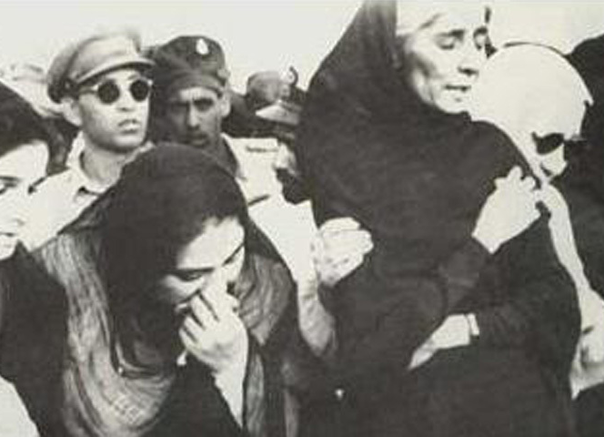
1950s
Jinnah s funeral

Slide 9
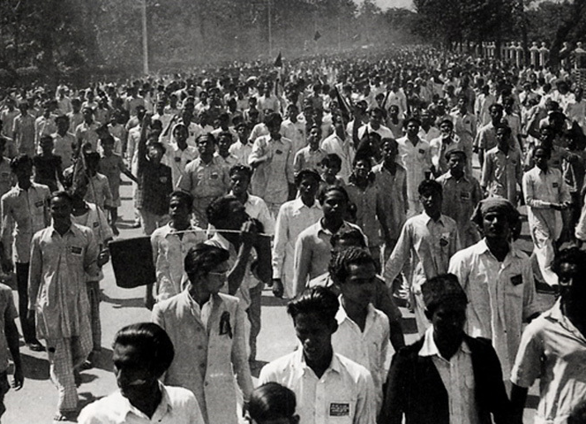
1950s
Early divisions: College students at a rally in Dhaka (East Pakistan) protesting against the West Pakistan’s ‘discriminatory attitude towards the Bengali language and culture.’ (1953)

Slide 10
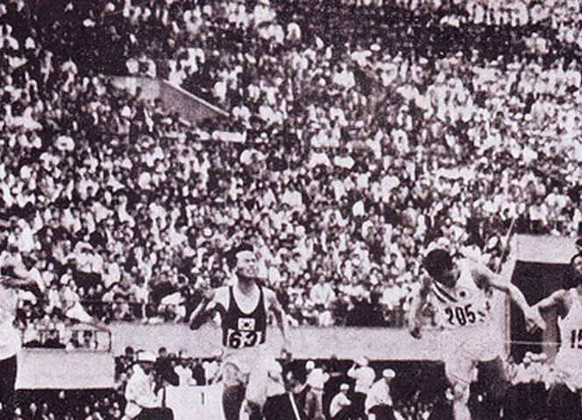
Pakistani sprinter, Abdul Khalique (left), on his way to winning Pakistan’s first international gold medal in athletics. He won this honour in the 1959 Commonwealth Games in the 100 meters dash.

Slide 11
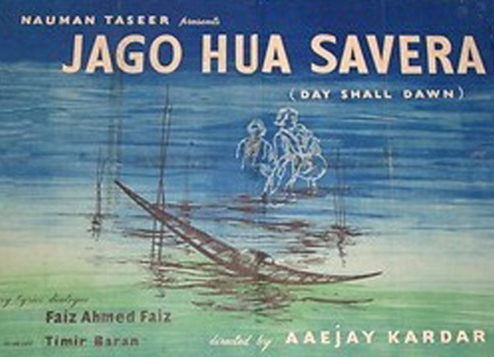
The poster of Pakistan’s first ‘socialist film’ Jago Hua Savera (The Day Shall Dawn)

Slide 12
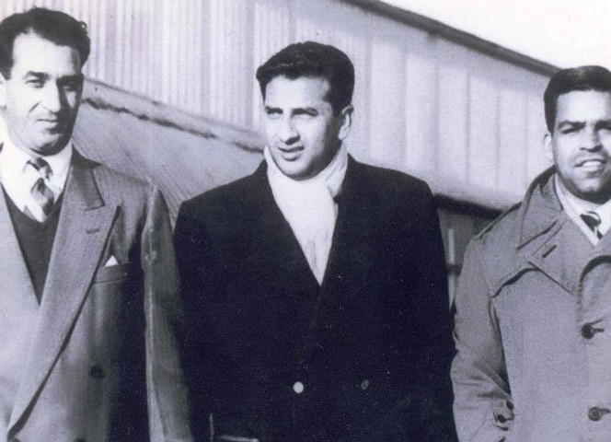
1950s
Pak got test status in 1952

